Slide 1
A Descriptive Study of
K-Means Clustering for Image Segmentation
In Bioinformatics
By-
Divyesh Saglani

Slide 2
Introduction
Genetic Algorithms are one of the most applied class of algorithms for solving global/multi-modal optimization problems and have been extensively studied for solving NP-hard optimization problems.
Graph clustering is an efficient methodology to detect groups of entities in a network or graph, possessing certain similar characteristics.
The genome projects are generating large amounts of biological data and so the data can be perplexing and confusing. Data clustering approaches can group similar data into clusters, which will reveal important biological meanings.
This clustering is widely used in image segmentation.

Slide 3
Introduction
Image segmentation is used to classify the pixels of an image correctly in a decision oriented application.
One of the most used clustering algorithm is k-means clustering algorithm.
It is simple and computationally faster than the hierarchical clustering. And it can also work for large number of variable.
It is required to initialize the k number of centroid. Different value of initial centroid would result different cluster.
Image segmentation becomes one of important tool in medical area where it is used to extract or region of interest from the background. So medical images are segmented using different technique and process outputs are used for the further analysis in medical.

Slide 4
Related Work
Alan Jose, S. Ravi and M. Sambath proposed Brain Tumor Segmentation using K-means Clustering and Fuzzy C-means Algorithm and its area calculation (Dhanachandra, 2015 & Küçükkülahli, 2016).
Genetic algorithms are used for detecting money-laundering by finding the clusters in a graph, constructed using financial and customer data (AlsedÃ, 2012).
K-Means Clustering Algorithms used for clustering the pixels of an image for image color quantization (Hamerly, 2015).
K-Means Clustering Algorithms used for post-processing to decide the memberships in spectral clustering (Hamerly, 2015).
Genetic Algorithms have been used for pattern recognition (Tang, 1996).
Notes:
Spectral clustering is technique make use of spectrum or eigenvalues to reduce dimensions for clustering.
Money laundering is concealment of origins of illegally obtained money.
5. Q = 1 2w X i X j (wij − wiwj 2w )δ(Ci , Cj )

Slide 5
Related Work
Newman and Girvan highlighted the relevance of the community structure in complex networks and proposed a method to detect it (AlsedÃ, 2012).
Madhu Yedla, Srinivasa Rao Pathakota, T. M. Srinivasa proposed Enhancing K-means clustering algorithm with improved initial center (Hamerly, 2015).
K. A. Abdul Nazeer, M. P. Sebastian proposed an enhanced algorithm to improve the accuracy and efficiency of the k-means clustering algorithm (Hamerly, 2015).
The implementation of Lloyd’s k-means clustering algorithm and Progressive Greedy k-means clustering algorithm was done and the algorithms were compared by Gregory A. Wilkin and Xiuzhen Huang (Wilkin, 2007).
A lot of other works have already been done but the researches are still being conducted to find out if these algorithms can be improved in some ways (Küçükkülahli, 2016).
Notes:
For example: - computational complexity and extra software functionality are required, so if they can be improved or not and other facilities
Many things use k-means clustering, one of them being Recommender System as told by Parth.

Slide 6
Research Methodology
Genetic Algorithms
Clustering Algorithms (GAC) and (GACN)
K-Means Clustering
Brain Tumor and MRI using image segmentation and k-means clustering
Image Segmentation using k-means clustering

Slide 7
Research Methodology
Genetic Algorithms: - It is a metaheuristic inspired by the process of natural selection that belongs to the larger class of evolutionary algorithms and are commonly used to generate high-quality solutions to optimization and search problems by relying on bio-inspired operators such as mutation, crossover and selection.
Clustering Algorithms: - These are types of genetic algorithms and here have been used to find the best fit cluster. Iteratively divide the graph in two best fit union of clusters at every step, discard the group of clusters which does not contain the desired node and repeat this process in the remaining subgraph. Are of 2 types: -
GAC - Genetic Clustering Algorithm
GACN - Genetic Algorithm : Cluster of node
Notes:
How K-Means work : -In k-means clustering, it partitions a collection of data into a k number group of data11, 12. It classifies a given set of data into k number of disjoint cluster. K-means algorithm consists of two separate phases. In the first phase it calculates the k centroid and in the second phase it takes each point to the cluster which has nearest centroid from the respective data point.

Slide 8
Research Methodology
K- means Clustering: - Clustering is a method to divide a set of data into a specific number of groups. It’s one of the popular method is k-means clustering. It is popular due to its clarity, simplicity, and intuitive optimization function.
Image Segmentation using k-means clustering: - From the above concepts of genetic clustering algorithms and k-means clustering, and algorithm was formed and was implemented on images to see how different segments of images get affected due to k-means clustering algorithm.
Brain Tumor and MRI using image segmentation and k-means clustering: - The above concepts were then used to implement in real life problems,i .e. ,finding the tumor area in brain using image segmentation and k -means clustering.
Notes:
How K-Means work : -The methods naively compute all nk distances between each of the n clustered points and each of the k centers. After each iteration, the centers move and these distances may all change, requiring recomputation. But after observing from some results we notice the centers don’t move much, especially after the ﬁrst few iterations.

Slide 9



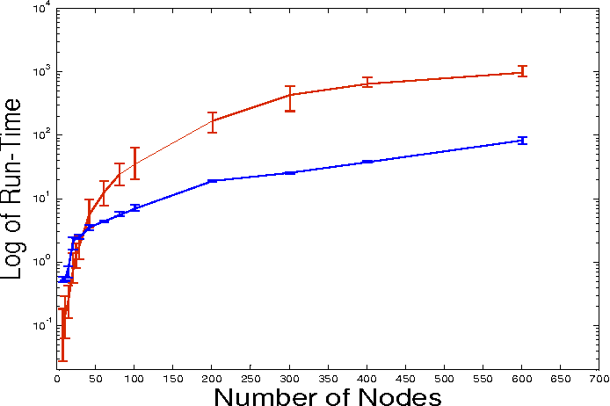
Results
Original Image
Fig1 with k = 5
Fig2 with k = 10
Figures for implementation of k-means clustering for image segmentation
# | Number of Nodes | Number of clusters | Run Time (GAC) seconds | Run time (GACN) seconds
1 | 11 | 2 | 0.15±0.056 | 0.54±.029
2 | 21 | 3 | 0.74±.0223 | 2.07±0.409
3 | 61 | 4 | 12.53±3.161 | 4.37±0.104
4 | 101 | 5 | 34.97±9.478 | 6.96±0.0541
5 | 301 | 15 | 430.90±110.5 | 25.53±0.508
6 | 401 | 10 | 643.23±170.032 | 37.61±0.625
Error-plot of the logarithmic run-time; GAC (red), GACN (blue)
Results of GAC and GACN (runtime ± standard deviation)

Slide 10
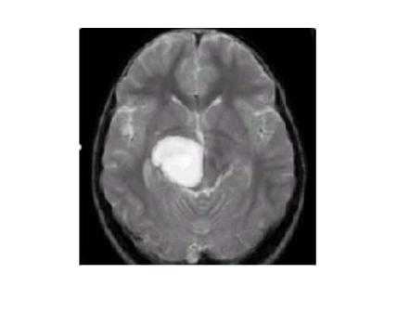
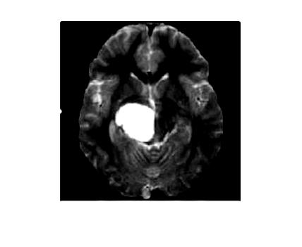
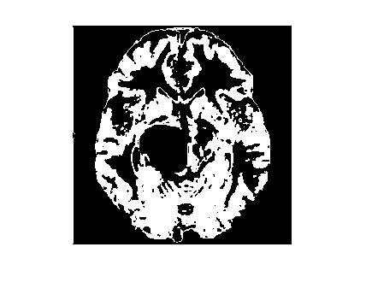
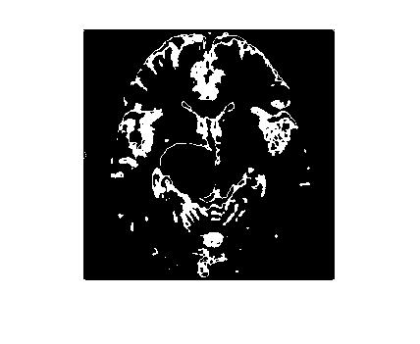
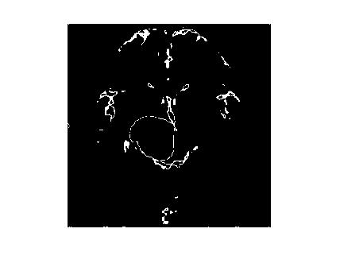
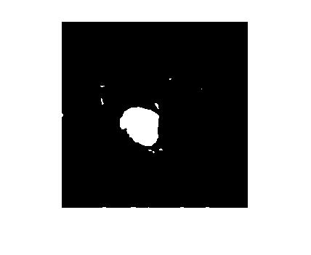
Results
Figure 2: Output image of tumor detection in brain using k-means clustering algorithm

Slide 11
Conclusion
Both algorithms, GAC and GACN were compared and it was found that GACN was better if number of nodes were high and this can be used money-laundering detection.
Image Segmentation using k-means clustering was then implemented and the resultant images were compared with different values of k, and the changes in segmentation of different clusters were noticed with change in value of k.
Then a real life example for image segmentation using k-means clustering was implemented, which was to check the development of tumor in brain and it was found that the stage of tumor can be calculated from this segmented image and also the shape can position can for found with least possible error.
Notes:
Money La : - we are interested in finding the community of a suspicious entity
Why need for segmentation: - if there is any noise are present in the MR image it is removed before the Kmeans process, gives clean image and thus further processes can be conducted without any problem

Slide 12
References
AlsedÃ , L., Awasthi, A., & LÃ¤ssig, J. (2012). Genetic Clustering Algorithms for Detecting Money-Laundering.
Hamerly, G., & Drake, J. (2015). Accelerating Lloyd’s algorithm for k-means clustering. In Partitional clustering algorithms (pp. 41-78). Springer, Cham.
Dhanachandra, N., Manglem, K., & Chanu, Y. J. (2015). Image segmentation using K-means clustering algorithm and subtractive clustering algorithm. Procedia Computer Science, 54(2015), 764-771.
Wilkin, G. A., & Huang, X. (2007, August). K-means clustering algorithms: Implementation and comparison. In Computer and Computational Sciences, 2007. IMSCCS 2007. Second International Multi-Symposiums on (pp. 133-136). IEEE.
Selvakumar, J., Lakshmi, A., & Arivoli, T. (2012, March). Brain tumor segmentation and its area calculation in brain MR images using K-mean clustering and Fuzzy C-mean algorithm. In Advances in Engineering, Science and Management (ICAESM), 2012 International Conference on (pp. 186-190). IEEE.

Slide 13
References
Küçükkülahli, E., Erdoğmuş, P., & Polat, K. (2016). Brain MRI segmentation based on different clustering algorithms. Brain, 155(3).
Dhanachandra, N., & Chanu, Y. J. (2015). Image Segmentation Method Using K-Means Clustering Algorithm for Color Image. Advanced Research in Electrical and Electronic Engineering, 2.
Man, K. F., Tang, K. S., & Kwong, S. (1996). Genetic algorithms: concepts and applications [in engineering design]. IEEE transactions on Industrial Electronics, 43(5), 519-534.
Bioinformatic Algorithms - Cambridge Computer Laboratory
Wu, M. N., Lin, C. C., & Chang, C. C. (2007, November). Brain tumor detection using color-based k-means clustering segmentation. In Intelligent Information Hiding and Multimedia Signal Processing, 2007. IIHMSP 2007. Third International Conference on (Vol. 2, pp. 245-250). IEEE.

